Slide 1


Salt Lake City
August 7th 2020 - Salt Lake City US
YFA-project
Virgile Colrat – weekly update
Department of Electrical and Computer Engineering – University of Utah

Slide 2
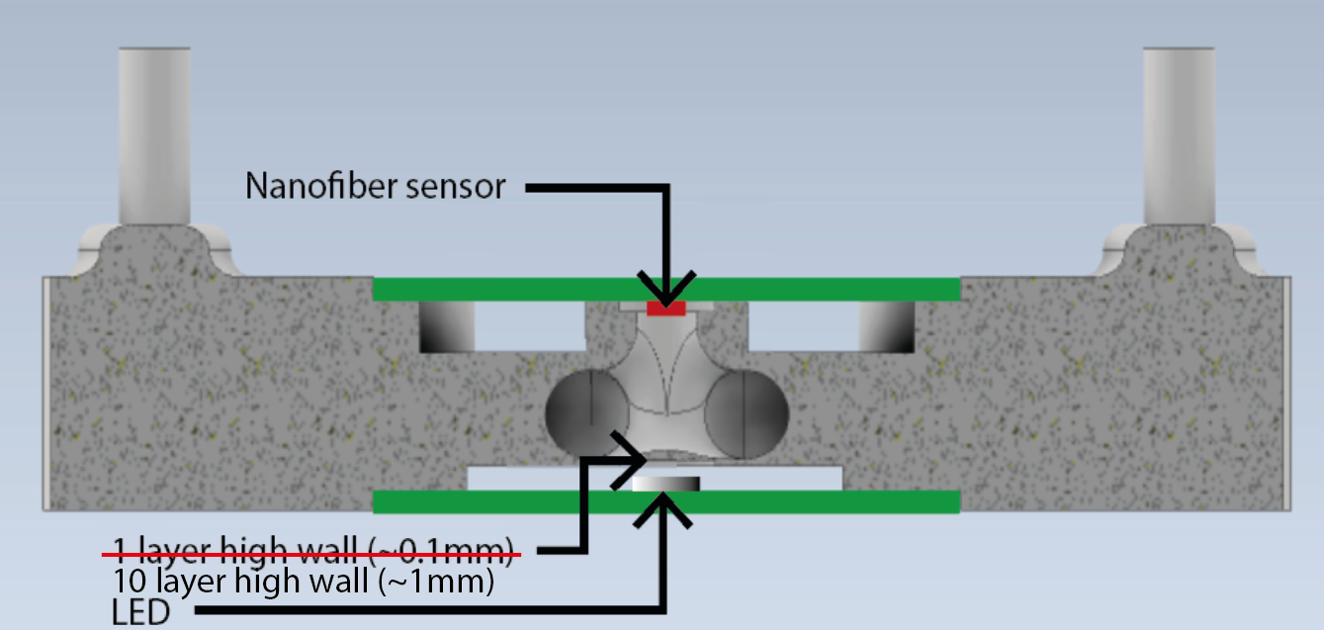
Update – Housing
New design of the housing to accomodate the LED for sensor illumination
The housing is now sandwidched between the LED PCB and the sensor PCB
The wall between the LED and gas line has been thickenned to eliminate leaks but still be semi-transparent

Slide 3
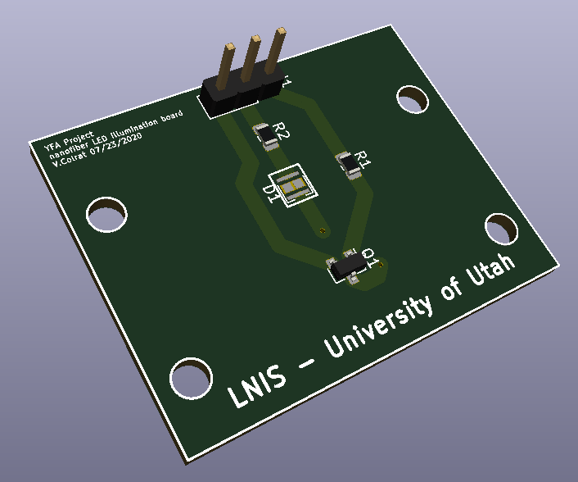
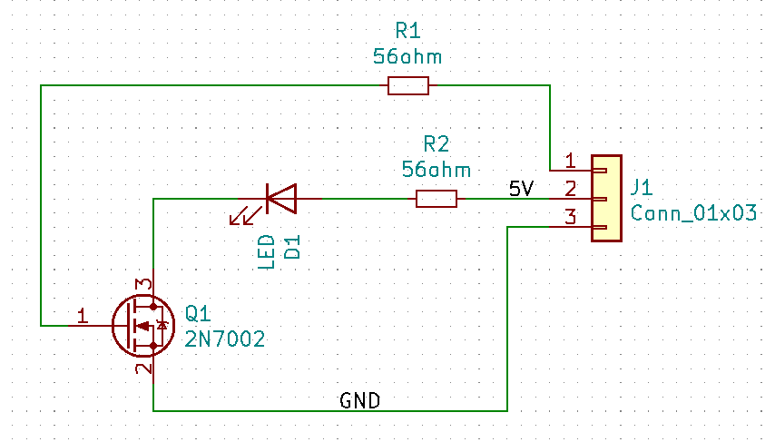
Update LED board PCB
The LED can be drived at constant voltage (by shorting pin 2 and 3 of the MOSFET) or with PWM (as is done in Vaporsens’s Pilot)

Slide 4
Update – Sensor results
Test of the sensors in ambient air with results very close to the results of Vaporsens:
The results are much better than last week because of I have used the same LED as Vaporsens for illumination of the fibers.
Some results (not shown here) shows that the results are very dependent on how close to the sensor the LED is placed. There is still room for improvement, I have to look at the Vaposens pilot to see how close the LED is to the sensor, is it direct illumination,etc.
Sensor Ref. | Current measured (Vaporsens) | Current measured (LNIS)
076.1 | 10.27nA | 9.294nA
076.2 | 11.03nA | 15.167nA
054 | 1.98nA | 2.417nA

Slide 5
Update – Chemicals sensor testing
I have sent an e-mail do Dana (at the general store), the told me the ammonia is arriving today at the U (07/23/2020) and it should be in the lab on Monday (07/27/2020)
I should be able to start testing right away
I am still waiting for the permeation oven to be ready on Vaporsens side

Slide 6


Laboratory for NanoIntegrated Systems Department of Electrical and Computer Engineering MEB building – University of Utah – Salt Lake City – UT – USA
Thank you for your attention
Questions?

